Slide 1
CS 179: Lecture 17
Convolutional Nets in cuDNN

Slide 2
Last Time
Motivation for convolutional neural nets
Forward and backwards propagation algorithms for convolutional neural nets (at a high level)
Down-sampling data using pooling operations
Foreshadowing to how we will use cuDNN to do it

Slide 3
Today
Understanding cuDNN’s internal representations for convolutions and pooling objects
Implementing convolutional nets using cuDNN

Slide 4
Representing Convolutions
Adding on to tensors and their descriptors, we now also have cudnnFilterDescriptor_t (to describe a conv kernel/filter) and cudnnConvolutionDescriptor_t (to describe an actual convolution)
We also have a cudnnPoolingDescriptor_t to represent a pooling operation (max pool, mean pool, etc.)
These have their own constructors, accessors, mutators, and destructors

Slide 5
Convolutional Filters
cudnnFilterDescriptor_t
Allocate by calling cudnnCreateFilterDescriptor( cudnnFilterDescriptor_t *filterDesc)
Free by calling cudnnDestroyFilterDescriptor( cudnnFilterDescriptor_t filterDesc)
The filter itself is just an array of numbers on the device
We will be using 4D arrays to store filters
However, this is still just a long linear array, like everything else

Slide 6
Convolutional Filters
cudnnFilterDescriptor_t
Set by calling cudnnSetFilter4dDescriptor( cudnnFilterDescriptor_t filterDesc, cudnnDataType_t datatype, cudnnTensorFormat_t format, int k, int c, int h, int w)
Use TENSOR_FORMAT_NCHW for format parameter
k = # of output channels, c = # of input channels

Slide 7
Convolutional Filters
cudnnFilterDescriptor_t
Get contents by calling cudnnGetFilter4dDescriptor( cudnnFilterDescriptor_t filterDesc, cudnnDataType_t *datatype, cudnnTensorFormat_t *format, int *k, int *c, int *h, int *w)
As usual, this function returns by setting pointers to output parameters

Slide 8
Describing Convolutions
cudnnConvolutionDescriptor_t
Allocate with cudnnCreateConvolutionDescriptor( cudnnConvolutionDescriptor_t *convDesc)
Free with cudnnDestroyConvolutionDescriptor( cudnnConvolutionDescriptor_t convDesc)
We will be considering 2D convolutions only

Slide 9
Describing Convolutions
cudnnConvolutionDescriptor_t
Set with cudnnSetConvolution2dDescriptor( cudnnConvolutionDescriptor_t convDesc, int pad_h, int pad_w, int u, int v, int dilation_h, int dilation_w, cudnnConvolutionMode_t mode, cudnnDataType_t computeType)

Slide 10
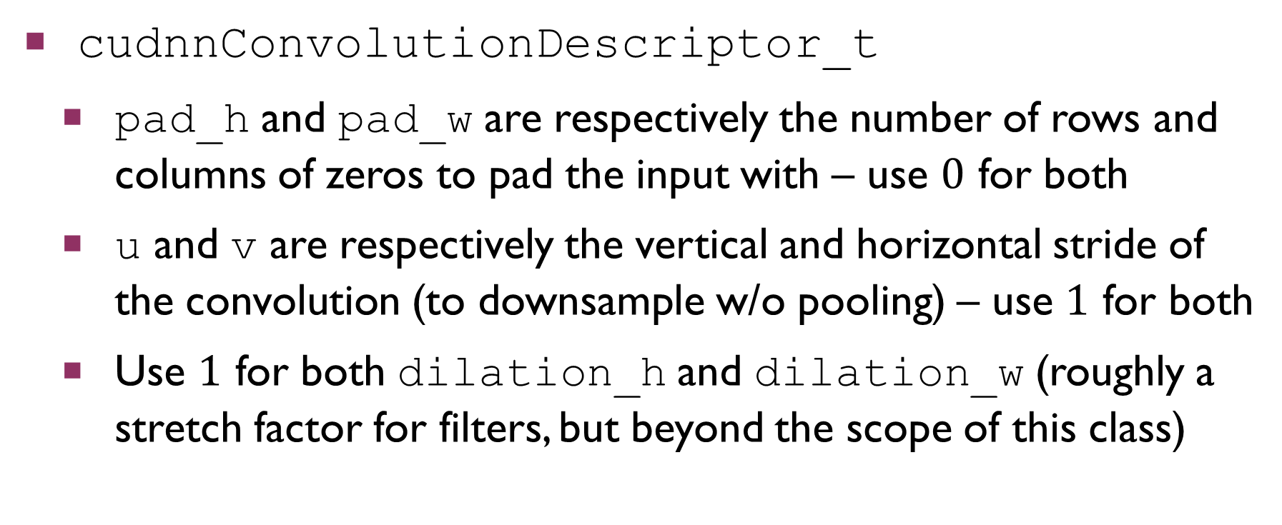
Describing Convolutions
cudnnConvolutionDescriptor_t
pad_h and pad_w are respectively the number of rows and columns of zeros to pad the input with – use $0$ for both
u and v are respectively the vertical and horizontal stride of the convolution (to downsample w/o pooling) – use $1$ for both
Use $1$ for both dilation_h and dilation_w (roughly a stretch factor for filters, but beyond the scope of this class)

Slide 11
Describing Convolutions
cudnnConvolutionDescriptor_t
cudnnConvolutionMode_t is an enum saying whether to do a convolution or cross-correlation. For this set, use CUDNN_CONVOLUTION for the mode argument.
cudnnDataType_t is an enum indicating the kind of data being used (float, double, int, long int, etc.). For this set, use CUDNN_DATA_FLOAT for the computeType argument.

Slide 12
Describing Convolutions
cudnnConvolutionDescriptor_t
Get with cudnnGetConvolution2dDescriptor( cudnnConvolutionDescriptor_t convDesc, int *pad_h, int *pad_w, int *u, int *v, int *dilation_h, int *dilation_w, cudnnConvolutionMode_t *mode, cudnnDataType_t *computeType)

Slide 13
Describing Convolutions
Given descriptors for an input and the filter we want to convolve it with, we can get the shape of the output via cudnnGetConvolution2dForwardOutputDim( cudnnConvolutionDescriptor_t convDesc, cudnnTensorDescriptor_t inputTensorDesc, cudnnFilterDescriptor_t filterDesc, int *n, int *c, int *h, int *w)
As usual, n, c, h, and w are set by reference as outputs

Slide 14
Using these In a Conv Net
All of cuDNN’s functions for forward and backward passes in conv nets will extensively use these descriptor types
This is why we are establishing them now, rather than later
One more aside before discussing the actual functions for doing the forward and backward passes…

Slide 15
Convolution Algorithms
There are many ways to perform convolutions!
Do it explicitly
Turn it into a matrix multiplication
Use FFT to transform into frequency domain, multiply pointwise, and inverse FFT back
cuDNN lets you choose the algorithm you want to use for all operations in the forward and backward passes

Slide 16
Convolution Algorithms
Different algorithms are better suited for different situations!
Most important factor: amount of global memory available for intermediate computations (workspace)
Tradeoff b/w time and space complexity – faster algorithms tend to need more space for intermediate computations
cuDNN lets you specify preferences, and it gives you an algorithm that best matches your preferences

Slide 17
Convolution Algorithms
The choice of algorithm is represented via the enums cudnnConvolution<type>Preference_t and cudnnConvolution<type>Algo_t, and cudnnConvolution<type>AlgoPerf_t, where <type> is one of Fwd, BwdFilter, and BwdData
Feel free to look at NVIDIA docs for these types and related functions, but we will be handling them for you in HW6

Slide 18
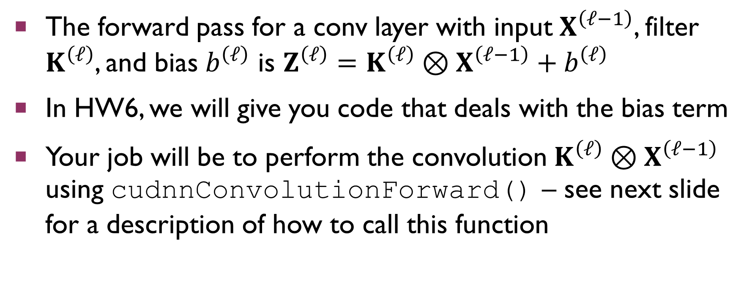
Forward Pass: Convolution
The forward pass for a conv layer with input $X^{\left(ℓ−1\right)}$, filter $K^{\left(ℓ\right)}$, and bias $b^{\left(ℓ\right)}$ is $Z^{\left(ℓ\right)}=K^{\left(ℓ\right)}⊗X^{\left(ℓ−1\right)}+b^{\left(ℓ\right)}$
In HW6, we will give you code that deals with the bias term
Your job will be to perform the convolution $K^{\left(ℓ\right)}⊗X^{\left(ℓ−1\right)}$ using cudnnConvolutionForward() – see next slide for a description of how to call this function

Slide 19
Forward Pass: Convolution
cudnnConvolutionForward( cudnnHandle_t handle, void *alpha, cudnnTensorDescriptor_t xDesc, void *x, cudnnFilterDescriptor_t kDesc, void *k, cudnnConvolutionDescriptor_t convDesc, cudnnConvolutionFwdAlgo_t algo, void *workSpace, size_t workSpaceBytes, void *beta, cudnnTensorDescriptor_t zDesc, void *z)

Slide 20
Forward Pass: Convolution
This function sets the contents of the output tensor z to alpha[0] * conv(k, x) + beta[0] * z
The convolution algorithm, workspace, and size of the workspace will be supplied to you in HW6 (unnecessary complication for you to consider for this set)
With alpha[0] = 1 and beta[0] = 0, this is exactly what you need to call!

Slide 21
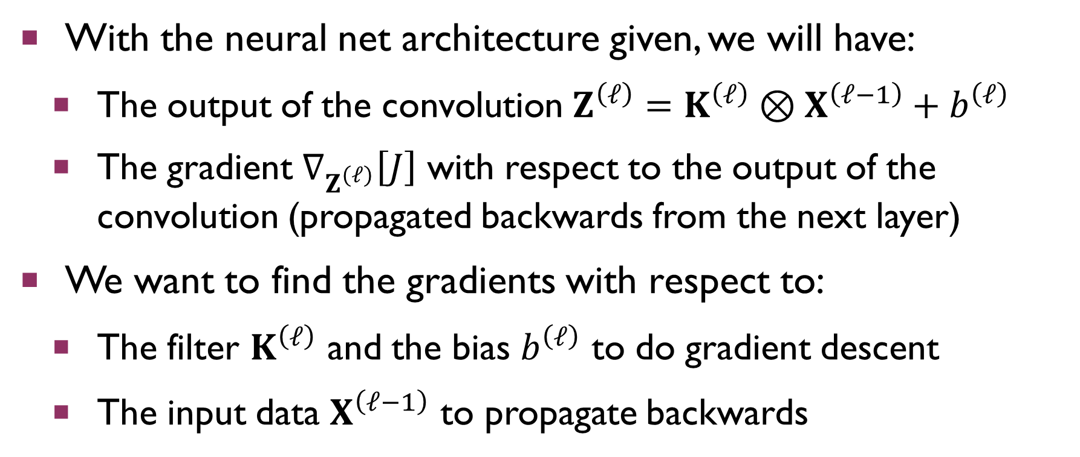
Backward Pass: Convolution
With the neural net architecture given, we will have:
The output of the convolution $Z^{\left(ℓ\right)}=K^{\left(ℓ\right)}⊗X^{\left(ℓ−1\right)}+b^{\left(ℓ\right)}$
The gradient $∇_{Z^{\left(ℓ\right)}}\left[J\right]$ with respect to the output of the convolution (propagated backwards from the next layer)
We want to find the gradients with respect to:
The filter $K^{\left(ℓ\right)}$ and the bias $b^{\left(ℓ\right)}$ to do gradient descent
The input data $X^{\left(ℓ−1\right)}$ to propagate backwards

Slide 22
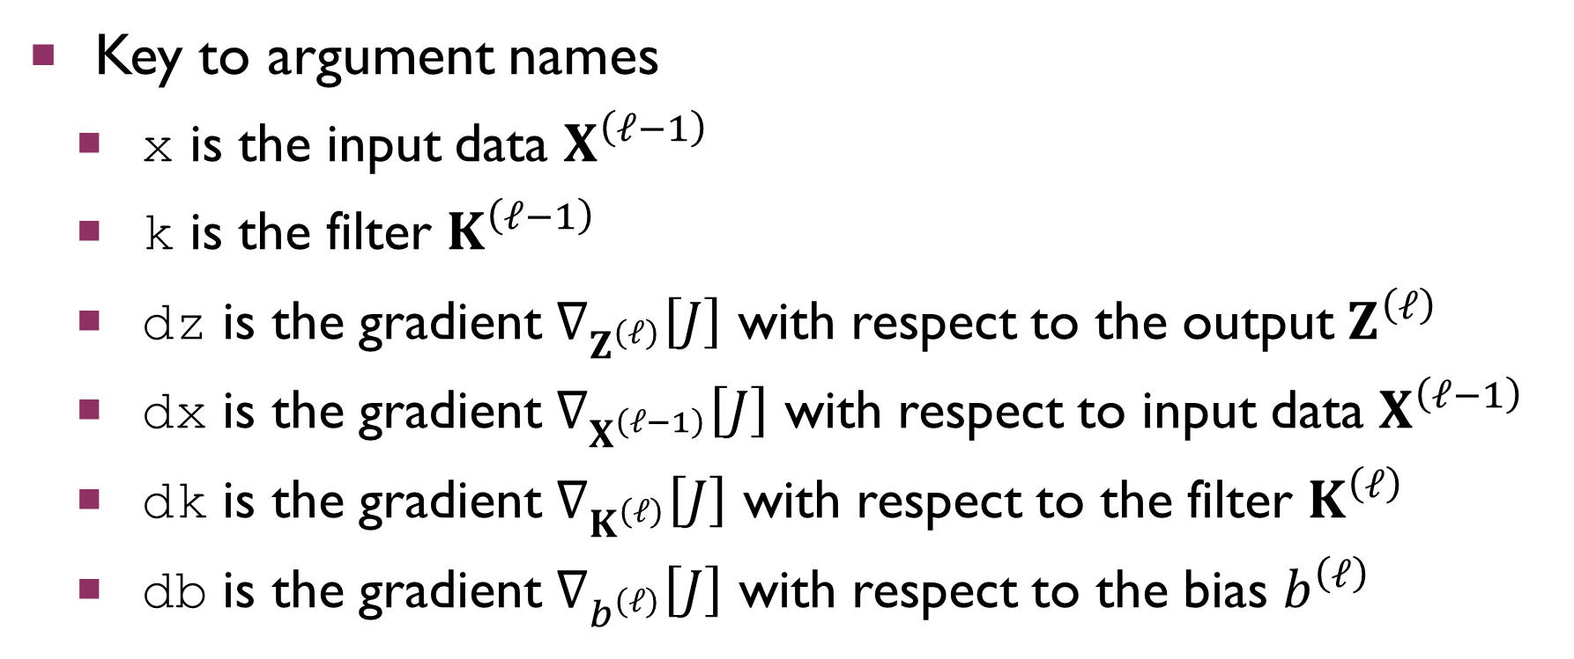
Backward Pass: Convolution
Key to argument names
x is the input data $X^{\left(ℓ−1\right)}$
k is the filter $K^{\left(ℓ−1\right)}$
dz is the gradient $∇_{Z^{\left(ℓ\right)}}\left[J\right]$ with respect to the output $Z^{\left(ℓ\right)}$
dx is the gradient $∇_{X^{\left(ℓ−1\right)}}\left[J\right]$ with respect to input data $X^{\left(ℓ−1\right)}$
dk is the gradient $∇_{K^{\left(ℓ\right)}}\left[J\right]$ with respect to the filter $K^{\left(ℓ\right)}$
db is the gradient $∇_{b^{\left(ℓ\right)}}\left[J\right]$ with respect to the bias $b^{\left(ℓ\right)}$

Slide 23
Backward Pass: Convolution
Key to argument names
As always, the alpha and beta arguments are pointers to mixing parameters
If we are using a buffer out to accumulate the results of performing an operation op on an input buffer in, we have out = alpha[0] * op(in) + beta[0] * out

Slide 24
Gradient WRT Bias
cudnnConvolutionBackwardBias( cudnnHandle_t handle, void *alpha, cudnnTensorDescriptor_t dzDesc, void *dz, cudnnConvolutionDescriptor_t convDesc, void *beta, cudnnTensorDescriptor_t dbDesc, void *db)
We will handle this for you in HW6

Slide 25
Gradient WRT Filter
cudnnConvolutionBackwardFilter( cudnnHandle_t handle, void *alpha, cudnnTensorDescriptor_t xDesc, void *x, cudnnTensorDescriptor_t dzDesc, void *dz, cudnnConvolutionDescriptor_t convDesc, cudnnConvolutionBwdFilterAlgo_t algo, void *workSpace, size_t workSpaceBytes, void *beta, cudnnFilterDescriptor_t dkDesc, void *dk)

Slide 26
Gradient WRT Input Data
cudnnConvolutionBackwardData( cudnnHandle_t handle, void *alpha, cudnnFilterDescriptor_t kDesc, void *k, cudnnTensorDescriptor_t dzDesc, void *dz, cudnnConvolutionDescriptor_t convDesc, cudnnConvolutionBwdDataAlgo_t algo, void *workSpace, size_t workSpaceBytes, void *beta, cudnnTensorDescriptor_t dxDesc, void *dx)

Slide 27
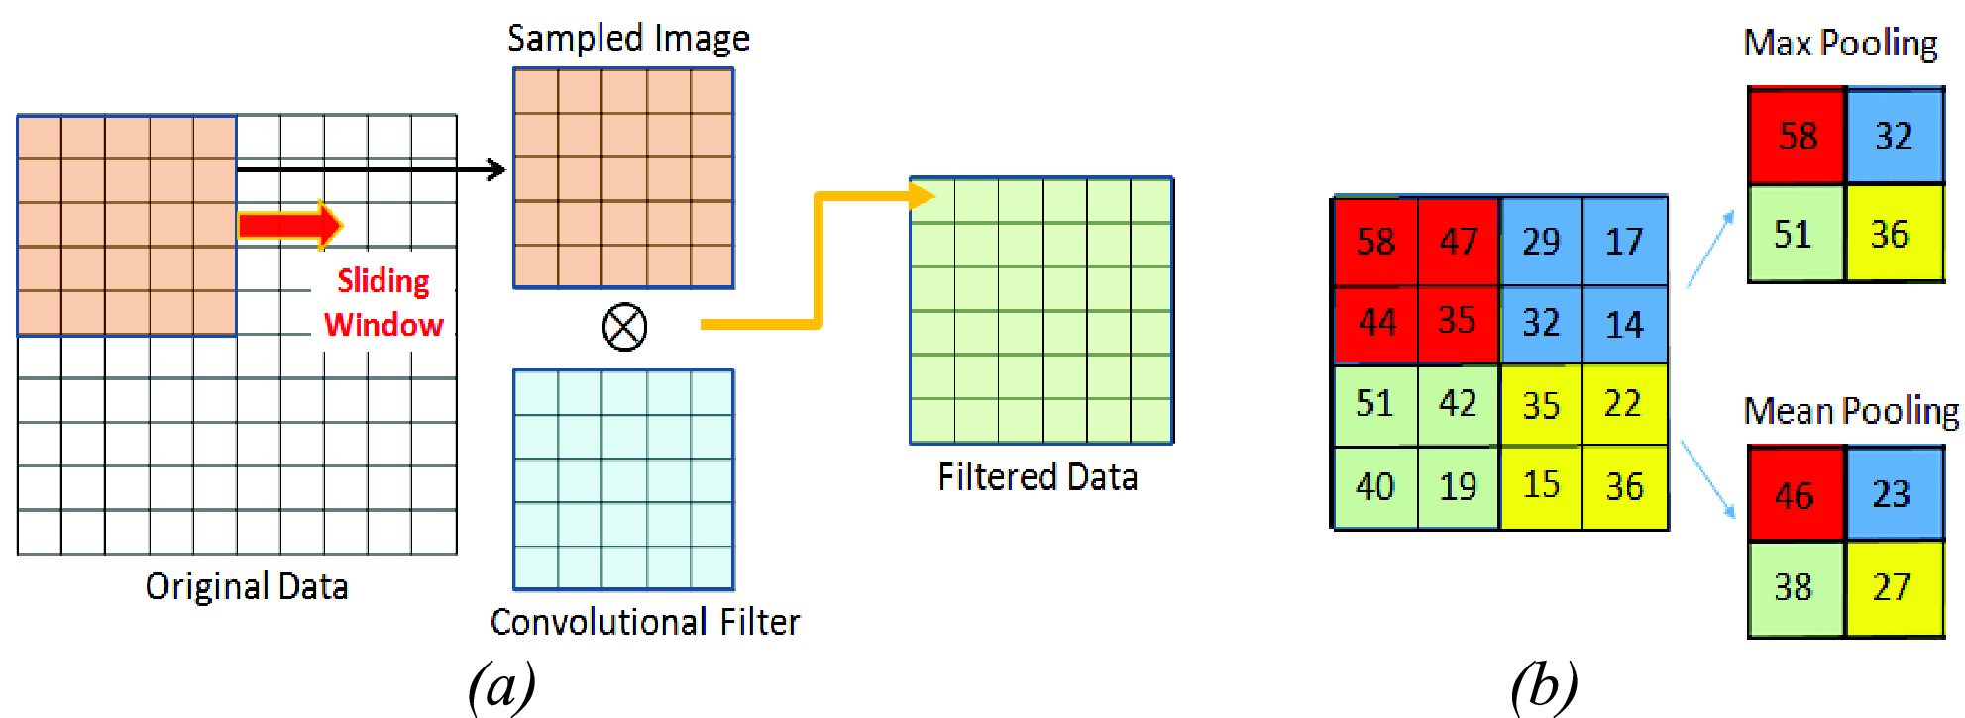
Pooling Operations
Reminder: pooling lets us down-sample images to make them more manageable (reduce dimensionality)
http://ieeexplore.ieee.org/document/7590035/all-figures

Slide 28
Pooling Operations
cudnnPoolingDescriptor_t
Allocate with cudnnCreatePoolingDescriptor( cudnnPoolingDescriptor_t *poolingDesc)
Free with cudnnDestroyPoolingDescriptor( cudnnPoolingDescriptor_t poolingDesc)
We will only be using 2D pooling operations in HW6

Slide 29
Pooling Operations
cudnnPoolingDescriptor_t
Set with cudnnSetPooling2dDescriptor( cudnnPoolingDescriptor_t poolingDesc, cudnnPoolingMode_t poolingMode, cudnnNanPropagation_t nanProp, int windowHeight, int windowWidth, int verticalPad, int horizontalPad, int verticalStride, int horizontalStride)

Slide 30
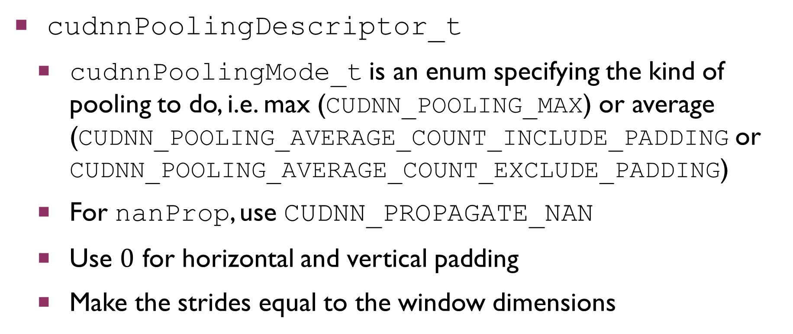
Pooling Operations
cudnnPoolingDescriptor_t
cudnnPoolingMode_t is an enum specifying the kind of pooling to do, i.e. max (CUDNN_POOLING_MAX) or average (CUDNN_POOLING_AVERAGE_COUNT_INCLUDE_PADDING or CUDNN_POOLING_AVERAGE_COUNT_EXCLUDE_PADDING)
For nanProp, use CUDNN_PROPAGATE_NAN
Use $0$ for horizontal and vertical padding
Make the strides equal to the window dimensions

Slide 31
Pooling Operations
cudnnPoolingDescriptor_t
Get with cudnnGetPooling2dDescriptor( cudnnPoolingDescriptor_t *poolingDesc, cudnnPoolingMode_t *poolingMode, cudnnNanPropagation_t *nanProp, int *windowHeight, int *windowWidth, int *verticalPad, int *horizontalPad, int *verticalStride, int *horizontalStride)

Slide 32
Pooling Operations
We can get the output shape of a pooling operation on some input using the function
cudnnGetPooling2dForwardOutputDim( cudnnPoolingDescriptor_t poolingDesc, cudnnTensorDescriptor_t inputDesc, int *n, int *c, int *h, int *w)
n, c, h, and w are output parameters to be set by reference

Slide 33
Pooling Operations
To perform a pooling operation in the forward direction, use
cudnnPoolingForward( cudnnHandle_t handle, cudnnPoolingDescriptor_t poolingDesc, void *alpha, cudnnTensorDescriptor_t xDesc, void *x, void *beta, cudnnTensorDescriptor_t zDesc, void *z)

Slide 34
Pooling Operations
To differentiate with respect to a pooling operation, use
cudnnPoolingBackward( cudnnHandle_t handle, cudnnPoolingDescriptor_t poolingDesc, void *alpha, cudnnTensorDescriptor_t zDesc, void *z, cudnnTensorDescriptor_t dzDesc, void *dz, void *beta, cudnnTensorDescriptor_t dxDesc, void *dx)

Slide 35
Pooling Operations
In the previous slides, x is the input to the pooling operation, dx is its gradient, z is the output of the pooling operation, and dz is its gradient
alpha and beta are pointers to mixing parameters as usual
In all cases, the last buffer given as an argument is the output array

Slide 36
Summary
Today, we discussed how to use cuDNN to
Perform convolutions
Backpropagate gradients with respect to convolutions
Perform pooling operations and backpropagate their gradients
For HW6, these slides should be a good alternative reference to the NVIDIA docs.

